Slide 1
Proportion, Non-parametric Tests and Two-way ANOVA
Introduction to Statistics

Slide 2
Agenda
Test for Population Proportion
One Sample
Two Sample
Non-Parametric Tests
One Sample
Wilcoxon Signed Rank Test
Two Sample
Wilcoxon Signed Rank Test
Wilcoxon Rank Sum Test
Mann-Whitney U Test
Post-Hoc Test for ANOVA and Two way ANOVA

Slide 3
Test for Population Proportion

Slide 4
Test for proportion
For qualitative data the proportion of a desired characteristic is obtained
Test for proportion:
One sample: Testing population proportion (P) is equal to a specified value (P₀)
Two sample: Testing equality of Two population proportions (P₁ = P₂)
Similar to the tests of population mean

Slide 5
One sample test - hypothesis
The hypothesis to test the population proportion is equal to a specified value
H₀ : P = P₀ against H₁ : P ≠ P₀
It implies
H₀: The population proportion is equal to P₀
against H₁: The population proportion is not equal to P₀
Failing to reject H₀ implies that the population proportion is equal to P₀

Slide 6
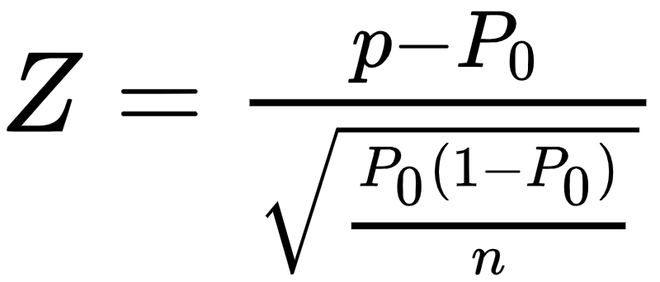
Test for proportions
The test statistic is given by
Sample proportion
Specified proportion
Sample size
Under H₀, the test statistic follows standard normal distribution

Slide 7
One sample test for proportion - decision rule
 | H₁ | Based on critical region | Based on p-value | Based on confidence interval
For two tailed test | P ≠ P₀ | Reject H₀ if |Z|> Z_{α/2} | Reject H₀ if p-value is less than level of significance | Reject H₀ if P₀ does not lie in the confidence interval
For left tailed test | P < P₀ | Reject H₀ if Z < -Z_{α}
For right tailed test | P > P₀ | Reject H₀ if Z > Z_{α}

Slide 8
One sample test for proportion
Question:
From a sample 361 business owners had gone into bankruptcy due to recession. On taking a survey, it was found that 105 of them had not consulted any professional for managing their finance before opening the business. Test the null hypothesis that at most 25% of all businesses had not consulted before opening the business.
Test the claim using p-value technique. [Use α = 0.05].

Slide 9
One sample test for proportion
Solution:
From a sample 361 business owners had gone into bankruptcy due to recession. i.e. n = 361
On taking a survey, it was found that 105 of them had not consulted any professional for managing their finance before opening the business.
Let X: business which did not consult before x = 105
The sample proportion (p) = x/n = 105/361 = 0.2909

Slide 10
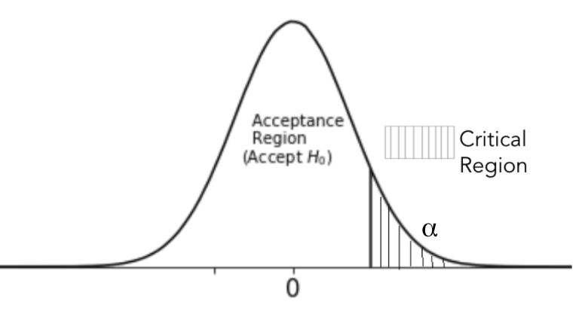
One sample test for proportion
Solution:
To test: The null hypothesis that at most 25% of all businesses had not consulted before opening the business
Here P₀ = 0.25
To test, H₀: P ≤ 25 against H₁: P > 25

Slide 11
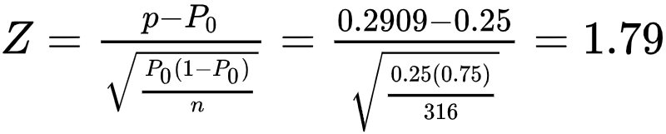
One sample test for proportion
Solution:
The test statistic
The p-value = P(Z > 1.79) = 0.0367
As p-value < 0.05, reject H₀.
We may conclude that at least 25% of all businesses had not consulted before starting the business.
1.79

Slide 12
Two sample tests for population proportion
Let there be two samples sizes n₁ and n₂ from different populations of such that x₁ and x₂ are the number of specific items in each of them respectively
Suppose these samples have proportions of specific items p₁ and p₂ respectively
To test the equality of population proportion from which these samples are chosen

Slide 13
Two sample test - hypothesis
The hypothesis to test the population proportion
H₀ : P₁ = P₂ against H₁ : P₁ ≠ P₂
It implies
H₀: The two population proportions are equal (P₁ = P₂)
against H₁: The two population proportions are not equal (P₁ ≠ P₂)
Failing to reject H₀ implies that the two population proportions are equal

Slide 14
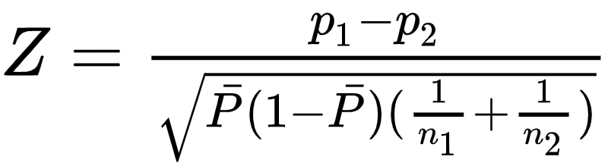
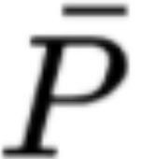
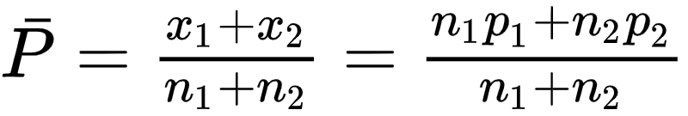
Test for proportions
The test statistic is given by
where is the proportion of pooled sample such that
Under H₀, the test statistic follows standard normal distribution

Slide 15
Two sample test for proportion - decision rule
 | H₁ | Based on critical region | Based on p-value | Based on confidence interval
For two tailed test | P₁ ≠ P₂ | Reject H₀ if |Z|> Z_{α/2} | Reject H₀ if p-value is less than level of significance | Reject H₀ if P₁ - P₂ does not lie in the confidence interval
For left tailed test | P₁ < P₂ | Reject H₀ if Z < -Z_{α}
For right tailed test | P₁ > P₂ | Reject H₀ if Z > Z_{α}

Slide 16
Two sample test for proportion
Question:
Steve owns a kiosk where sells two magazines - A and B in a month. He buys 100 copies of magazine A out of which 78 were sold and 70 copies of magazine B out of which 65 were sold. Is there enough evidence to say that magazine is B is more popular?
Test the claim using p-value technique. [Use α = 0.05].

Slide 17
Two sample test for proportion
Solution:
Steve owns a kiosk where sells two magazines - A and B in a month.
Let X: the number of magazines sold
Out of 100 copies of magazine A 78 are sold Here, x₁ = 78 and n₁ = 100 Let p₁ be the proportion of sell of magazine A p₁= x₁/n₁ = 78/100 = 0.78
Out of 70 copies of magazine B 65 are sold Here, x₂ = 65 and n₁ = 70 Let p₂ be the proportion of sell of magazine B p₂ = x₂/n₂ = 65/70 = 0.928

Slide 18
Two sample test for proportion
Solution:
To test, whether magazine B is more popular, i.e
H₀: P₁ ≥ P₂ against H₁: P₁ < P₂ Where P₁: denotes population proportion of magazine A sold P₂: denotes population proportion of magazine B sold

Slide 19
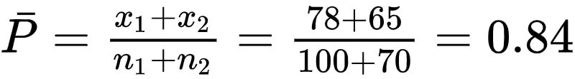
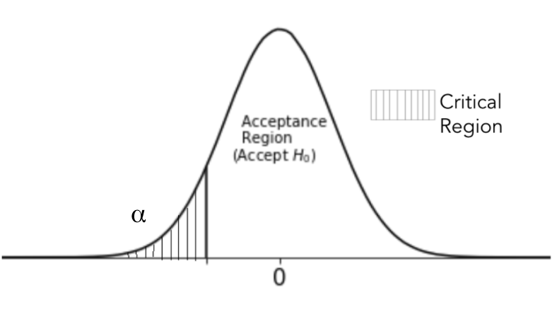

Two sample test for proportion
Solution:
The pooled proportion is
The test statistic is

Slide 20
Two sample test for proportion
Solution:
The test statistic Z = -2.5905
The p-value = P(Z < Z_{calc}, under H₀) = P(Z < -2.5905, µ = 13) = 0.0048
Since p-value < 0.05, we reject H₀.
Thus there is enough evidence to conclude that magazine is B is more popular.
-2.59

Slide 21
The python code to conduct a Z test for two population proportions is
statsmodels.api.stats.proportions_ztest(Sample_1, Sample_2)

Slide 22
Parametric tests
The tests considered so far have two features:
The probability distribution of the samples was assumed to be known
The hypothesis test was about the parameter of the probability distribution
These tests are known as the parametric tests
The times when these assumptions are not satisfied, use the non-parametric tests

Slide 23
Non-parametric Tests

Slide 24
Non-parametric tests
A test that does not depend on the particular form of the basic probability distribution from which the samples are drawn
The assumptions of a non-parametric test are
Sample observations are independent
Sample observations are random
These assumptions are weaker than those associated with the parametric tests
Applications in Psychometry, Sociology and Educational Statistics

Slide 25
Characteristics of non-parametric tests
Does not require complicated sampling theory
Can be applied to nominal or ordinal data, for instance blood group such as A⁺, AB⁻ and so on
No assumptions are made about the form of probability distribution of the parent population, hence are also known as Distribution Free methods
Tests are based on median, range, quartile and so on. Henceforth an ordered sample is desired

Slide 26
Ordered sample
Let x₁, x₂, …, x_{n} be a sample
The ordered sample for x₁, x₂, …, x_{n} is x₁≤ x₂≤ …≤ x_{n}
Example:
Let the sample be 23, 44, 10, 5, 39 The ordered sample is 5, 10, 23, 39, 44 since 5 ≤ 10 ≤ 23 ≤ 39 ≤ 44

Slide 27
Non-parametric Tests-One Sample

Slide 28
One sample test
To test for the location parameter of the sample equal to a specific value
The location parameter is considered to be the median
Use the Wilcoxon sign rank test

Slide 29
Wilcoxon signed rank test
Let x₁, x₂, .. x_{n} be a random sample of size n of the random variable X
Let F_{X}(.) be the distribution function and M be the median of the random variable
Assumption of Wilcoxon sign rank test
F_{X}(.) is continuous
F_{X}(.) is symmetric

Slide 30
Wilcoxon signed rank test
To test,
H₀ : M = M₀ against H₁ : M ≠ M₀
H₀ : M ≤ M₀ against H₁ : M > M₀
H₀ : M ≥ M₀ against H₁ : M < M₀

Slide 31
Wilcoxon signed rank test
Procedure:
Compute the D_{i} = X_{i} - M₀
Rank |D_{i}|, where 1 is assigned to the smallest difference
The test statistic is given by
where
Failing to reject H₀, implies the median is equal to specified median value M₀
One sided test | T⁺
Two sided test | T = Min (T⁺,T⁻)
T⁺ | Sum of positive signed ranks
T⁻ | Sum of negative signed ranks

Slide 32
Wilcoxon signed rank test
Decision rule:
 | H₁ | Based on critical region
For left tailed test | M < M₀ | Reject H₀ if T⁺ ≤ T_{α,n}
For right tailed test | M > M₀ | Reject H₀ if T⁻ ≤ T_{α,n}
For two tailed test | M ≠ M₀ | Reject H₀ if T⁺ ≤ T_{α} or T ≥ T⁺_{α}

Slide 33
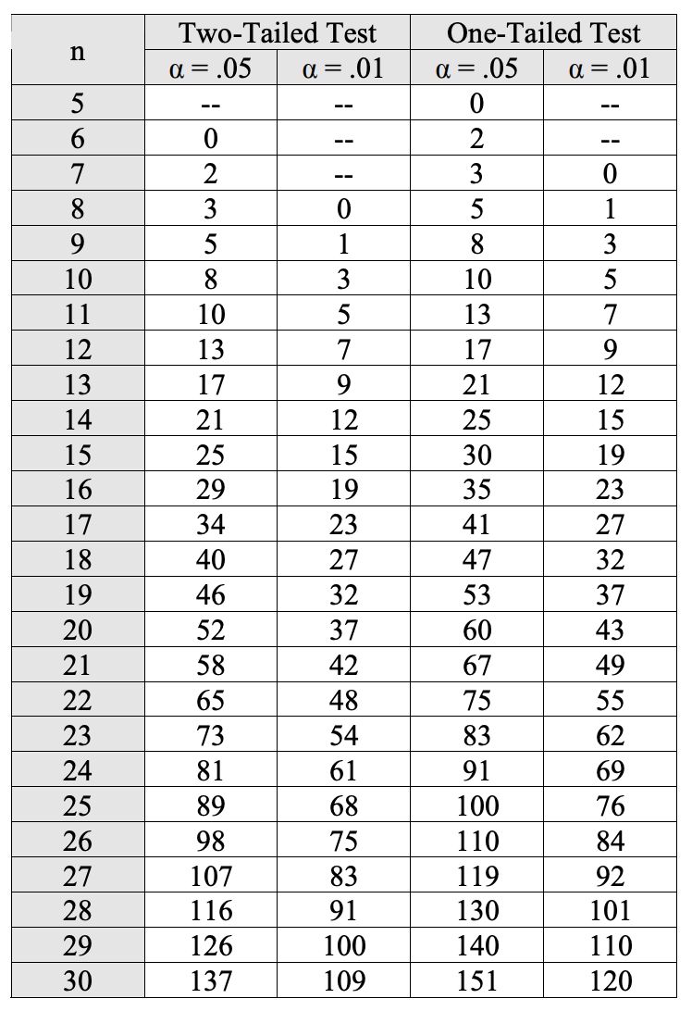
Wilcoxon signed rank test
Decision rule:
 | H₁ | Based on critical region
For left tailed test | M < M₀ | Reject H₀ if T⁺ ≤ T_{α,n}
For right tailed test | M > M₀ | Reject H₀ if T⁻ ≤ T_{α,n}
For two tailed test | M ≠ M₀ | Reject H₀ if T⁺ ≤ T_{α} or T ≥ T⁺_{α}

Slide 34
How to rank data?
Smallest rank is given to data with smallest magnitude.
Example:
Rank the data 21, 8, 5, 4, 10, 15, 30, 24
Unordered Data | 21 | 8 | 5 | 4 | 10 | 15 | 30 | 24
Ordered Data | 4 | 5 | 8 | 10 | 15 | 21 | 24 | 30
Rank | 1 | 2 | 3 | 4 | 5 | 6 | 7 | 8

Slide 35
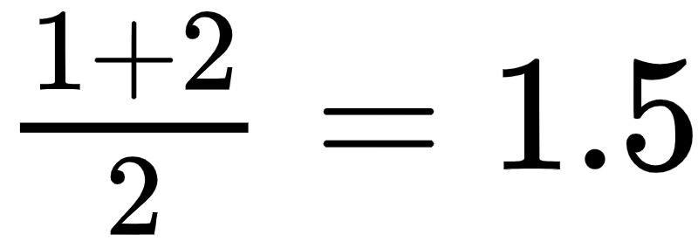
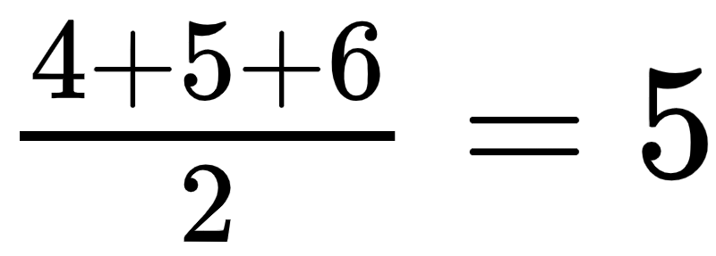
What to do in case of ties?
Take the average of ranks
Example: Rank the data 10, 21, 8, 5, 10, 30, 24, 10, 5
Unordered Data | 10 | 21 | 8 | 5 | 10 | 30 | 24 | 10 | 5
Ordered Data | 5 | 5 | 8 | 10 | 10 | 10 | 21 | 24 | 30
Rank without ties | 1 | 2 | 3 | 4 | 5 | 6 | 7 | 8 | 9
Working
Rank with ties | 1.5 | 1.5 | 3 | 5 | 5 | 5 | 7 | 8 | 9

Slide 36
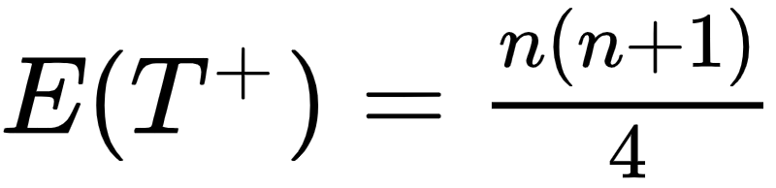
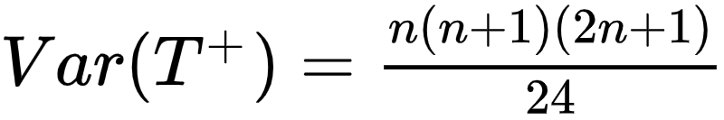
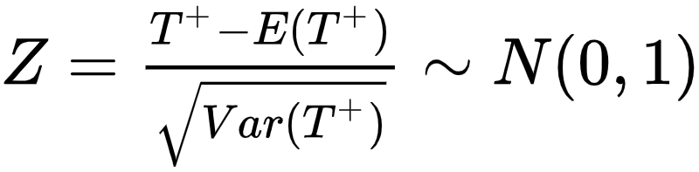
Wilcoxon signed rank test
The normal approximation is good for n ≥ 15
The limiting distribution of T⁺ is normal distribution such that
The Z statistic is
Approximation can also be used when critical values are not available in the table

Slide 37
One sample test
Question:
A company manufactures auto ancillaries. One of them are steel rods with median diameter 10 cm. A sample of 10 rods randomly selected from the production process gives the following results
Test the hypothesis that the median of population has reduced. [Use α = 0.05].
9.1 | 10.1 | 9.9 | 9.9 | 10 | 9.8 | 9.7 | 9.8 | 9.9 | 8.6

Slide 38
One sample test
Solution:
Let X: diameter of steel rod (in cm) Let M be the median of X
Here M₀ = 10
To test, H₀: M ≥ 10 against H₁: M < 10

Slide 39
One sample test
Solution:
Unordered X | 9.1 | 10.1 | 9.9 | 9.9 | 10 | 9.8 | 9.7 | 9.8 | 9.9 | 8.6
Ordered X | 8.6 | 9.1 | 9.7 | 9.8 | 9.8 | 9.9 | 9.9 | 9.9 | 10 | 10.1
D_{i} | -1.4 | -0.9 | -0.3 | -0.2 | -0.2 | -0.1 | -0.1 | -0.1 | 0 | 0.1
|D_{i}| | 1.4 | 0.9 | 0.3 | 0.2 | 0.2 | 0.1 | 0.1 | 0.1 | 0 | 0.1
Rank | 9 | 8 | 7 | 5.5 | 5.5 | 2.5 | 2.5 | 2.5 | - | 2.5
It is obvious that min(T⁺, T⁻) = T⁺ The test statistic T⁺ = Sum of positive signed ranks = 2.5

Slide 40
One sample test
Solution:
The test statistic T⁺ = 2.5
From the table T⁺ = 10
Since 10 > 2.5, reject H₀.
There is no sufficient evidence to claim that the median is 10.

Slide 41
The python code to conduct Wilcoxon Signed Rank test for one population is
scipy.stats.wilcoxon(Sample, alternative)

Slide 42
Non-parametric Tests - Two Sample

Slide 43
Non-parametric tests - two samples
Non-Parametric Tests (For Two Samples)
Paired Data
Unpaired Data
Wilcoxon Signed Rank Test
Wilcoxon Rank Sum Test
Mann-Whitney U test

Slide 44
Wilcoxon signed rank test
The wilcoxon test is also used for as a non-parametric alternative for a paired t test
It is done by simply taking the difference in each pair
Let x₁, x₂, .. x_{n} be a random sample of size n with distribution F_{X}(.) of random variable X and y₁, y₂, .. y_{n} be a random sample of size n with distribution F_{Y}(.) of random variable Y
It is assumed that the difference between the paired sample should be symmetric about the median

Slide 45
Wilcoxon signed rank test
To test,
H₀ : M_{d} = M₀ against H₁ : M_{d} ≠ M₀
H₀ : M_{d} ≤ M₀ against H₁ : M_{d} > M₀
H₀ : M_{d} ≥ M₀ against H₁ : M_{d} < M₀
Failing to reject H₀, implies the null hypothesis is true

Slide 46
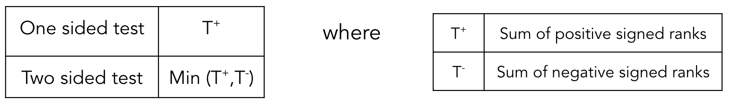
Wilcoxon signed rank test
Compute the D_{i} = X_{i} - Y_{i}
Rank |D_{i}|, where 1 is assigned to the smallest difference
The test statistic is given by

Slide 47
Wilcoxon signed rank test
Failing to reject H₀, implies the median is equal to specified median value M₀
The decision rule remain as that of one sample test

Slide 48
Non-parametric - paired data
Question:
The weights (in kg) of five hens is before and after a special diet of millets was given
Test the hypothesis that the new millet diet has increased the weight of the hens at 5% level of significance.
Before | 2.7 | 1.1 | 1.4 | 0.9 | 0.9
After | 1.3 | 1.4 | 1.1 | 1.3 | 1.9

Slide 49
Non-parametric - paired data
Solution:
Let X: weight (in kg) of hen before a special diet of millets
Let Y: weight (in kg) of hen after a special diet of millets
To test whether the the diet increases the weights i.e to test, H₀: M_{d} ≥ 0 against H₁: M_{d} < 0
Where M_{d} is the median of difference the weights before and after the diet.

Slide 50
Non-parametric - paired data
Solution:
X_{i} | 2.7 | 1.1 | 1.4 | 0.9 | 0.9
Y_{i} | 1.3 | 1.4 | 1.1 | 1.3 | 1.9
D_{i} | 1.4 | -0.3 | 0.3 | -0.4 | -0.6
|D_{i}| | 1.4 | 0.3 | 0.3 | 0.4 | 0.6
Rank | 5 | 1.5 | 1.5 | 3 | 4
It is obvious that min(T⁺, T⁻) = T⁺
The test statistic T⁺
= Sum of positive signed ranks
= 1.5 + 5
= 6.5

Slide 51
Non-parametric - paired data
Solution:
The test statistic T⁺ = 6.5
From the table T⁺ = 0
Since 6.5 > 0, fail to reject H₀.
There is not enough evidence to conclude that the new millets diet increase the weight of hens.

Slide 52
The python code to conduct Wilcoxon Signed Rank test for paired data is
scipy.stats.wilcoxon(Sample_1, Sample_2, alternative)

Slide 53
Wilcoxon rank sum test
Used for unpaired data
Test for the location parameter - median
Equivalent to Mann-Whitney U test provided there are no ties in the ranked data
Let x₁, x₂, .. x_{n} be a random sample of size n₁ with distribution F_{X}(.) of random variable X and y₁, y₂, .. y_{n} be a random sample of size n₂ with distribution F_{Y}(.) of random variable Y

Slide 54
Wilcoxon rank sum test
Assumptions:
F_{X}(.) and F_{Y}(.) are continuous
The samples differ only in their locations
The samples are independent
Let n₁ denote the observations of variable X and n₂ denote the observations of variable Y
Total observations N = n₁ + n₂

Slide 55
Wilcoxon rank sum test
Let m₁ denote the median of variable X and m₂ be the median of variable Y
Let M = m₁ - m₂
To test,
H₀ : M = 0 against H₁ : M ≠ 0
H₀ : M ≤ 0 against H₁ : M > 0
H₀ : M ≥ 0 against H₁ : M < 0

Slide 56
Wilcoxon rank sum test
Sort the combined data in ascending order and then rank it
The test statistic T is given by sum of ranks assigned to X
Failing to reject H₀, implies that two samples are drawn from identical distributions
Decision rule:
If H₁: M < 0, reject H₀ if T < T_{L}
If H₁: M > 0, reject H₀ if T > T_{U}
If H₁: M ≠ 0, reject H₀ if T < T_{L} or T > T_{U}

Slide 57
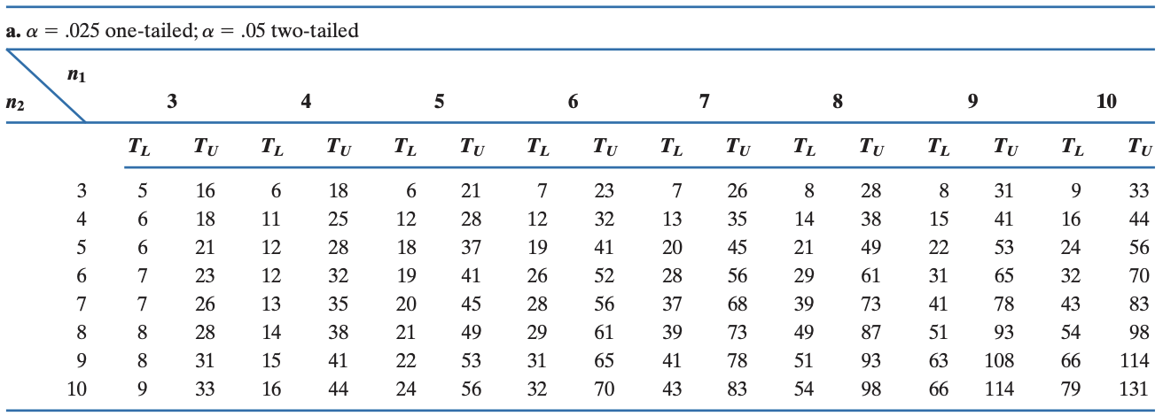
Wilcoxon rank sum test
Wilcoxon rank sum table for one sided test (α=0.025) and two sided test (α=0.05)

Slide 58
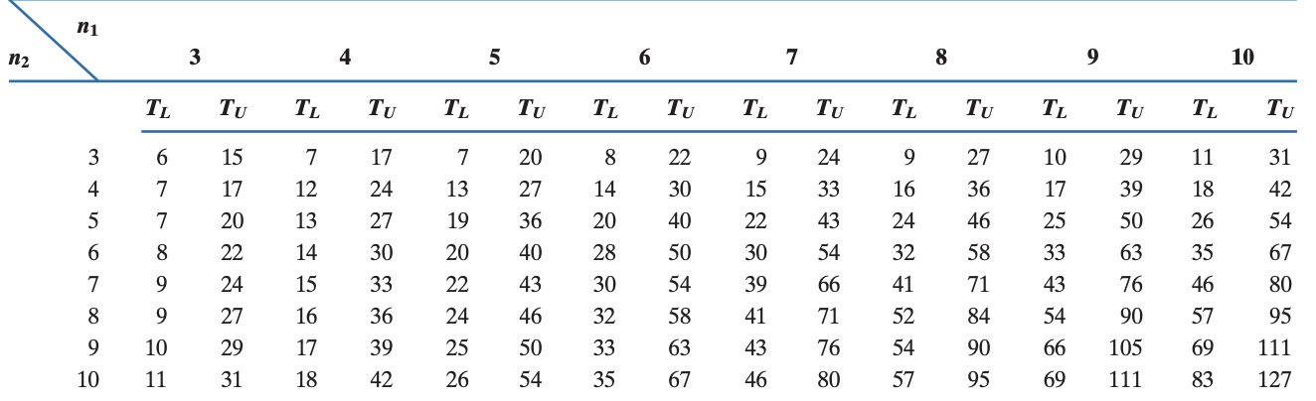
Wilcoxon rank sum test
Wilcoxon rank sum table for one sided test (α=0.05) and two sided test (α=0.1)

Slide 59
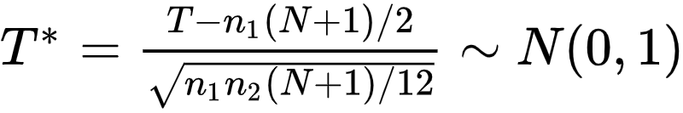
Wilcoxon rank sum test
The normality approximation:
as min(n₁,n₂) ￫ ∞
In general normal approximation is used when n₁, n₂ > 15

Slide 60
Non-parametric - unpaired data
Question:
The lengths of time in minutes spent in the operating room by 9 patients undergoing the same operating method. 4 patients are from hospital A and 5 are from hospital B
On the basis of these data can we conclude that for the sample operative method, patients in hospital B tend to be longer in hospital A.
A | 32 | 31 | 33 | 46
B | 49 | 20 | 58 | 55 | 52

Slide 61
Non-parametric - unpaired data
Solution:
Let X: the time spent by patient in hospital A in operating room Y: the time spent by patient in hospital B in operating room
To test: For the sample operative method, patients in hospital B tend to be longer in hospital A
H₀: Time spent by patients in both the hospital operating rooms is same i.e. M ≥ 0
Against
H₁: Time spent by patients in hospital B is more than that of patients of hospital A i.e. M < 0

Slide 62
Non-parametric - unpaired data
Solution:
Here, n₁ = 4 and n₂ = 5
The test statistic T = Sum of ranks assigned to X = 2 + 3 + 4 + 5 = 14
Pooled sample | 32 | 31 | 33 | 46 | 49 | 20 | 58 | 55 | 52
Ordered Sample | 20 | 31 | 32 | 33 | 46 | 49 | 52 | 55 | 58
Rank | 1 | 2 | 3 | 4 | 5 | 6 | 7 | 8 | 9
 | Data from X
 | Data from Y

Slide 63
Non-parametric - unpaired data
Solution:
The test statistic T = 14
Here, n₁ = 4 and n₂ = 5, thus T_{L} = 12
Decision rule: reject H₀ if T < T_{L}
Since T > T_{L}, we accept H₀.
We can not conclude that the patients of hospital B tend to spend more time in the operating room than patients of hospital A

Slide 64
The python code to conduct Wilcoxon Rank Sum for unpaired data is
scipy.stats.stats.ranksums(Sample_1, Sample_2)

Slide 65
Mann-whitney U test
Used for unpaired data
Test for the location parameter - median
Let x₁, x₂, .. x_{n1} be a random sample of size n₁ with distribution F_{X}(.) of random variable X and y₁, y₂, .. y_{n2} be a random sample of size n₂ with distribution F_{Y}(.) of random variable Y

Slide 66
Mann-whitney U test
Assumptions:
F_{X}(.) and F_{Y}(.) are continuous
The samples are independent
Let m₁ denote the median of variable X and m₂ be the median of variable Y
Total observations N = n₁ + n₂
Let M = m₂ - m₁

Slide 67
Mann-whitney U test
Let m₁ denote the median of variable X and m₂ be the median of variable Y
Let M = m₂ - m₁
To test,
H₀ : M = 0 against H₁ : M ≠ 0
H₀ : M ≤ 0 against H₁ : M > 0
H₀ : M ≥ 0 against H₁ : M < 0

Slide 68
Mann-whitney U test
However, the appropriate null hypothesis is that the two samples are drawn from identical distributions
The modified hypothesis are
H₀ : F_{X} = F _{Y} against H₁ : F_{X} ≠ F_{Y}
H₀ : F_{X} ≤ F _{Y} against H₁ : F_{X} > F_{Y}
H₀ : F_{X} ≥ F _{Y} against H₁ : F_{X} < F_{Y}

Slide 69
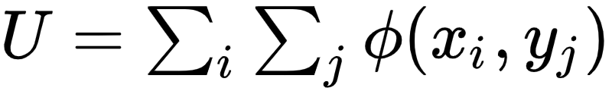
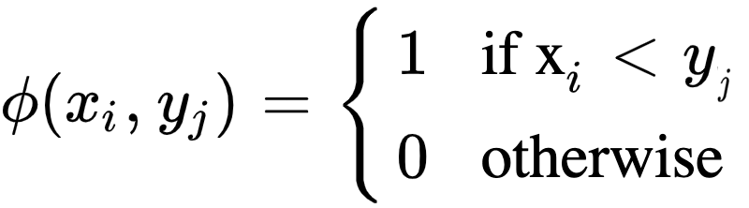
Mann-whitney U test
The assumptions and test hypothesis are similar Wilcoxon sum rank test
The test statistics are different but are equivalent
The test statistic is
where
The statistic U is the number of times x_{i} preceding y_{j} among all (x_{i}, y_{j}) pairs and U’ be the number of times x_{i} succeeding y_{j} among all (x_{i}, y_{j}) pairs

Slide 70
For no ties in the data, U + U’ = n₁.n₂

Slide 71
Mann-whitney U test
Wilcoxon test uses the ranks while Mann-Whitney test statistic measures the count
Decision rule: Reject H₀ if the value of test statistic is less than the table value

Slide 72
Non-parametric - unpaired data
Question:
The lengths of time in minutes spent in the operating room by 9 patients undergoing the same operating method. 4 patients are from hospital A and 5 are from hospital B
On the basis of these data can we conclude that for the sample operative method, patients in hospital B tend to be longer than in hospital A.
A | 32 | 31 | 33 | 46
B | 49 | 20 | 58 | 55 | 52

Slide 73
Non-parametric - unpaired data
Solution:
Let F_{X}: the distribution of time spent by patient in hospital A in operating room F_{Y}: the distribution of time spent by patient in hospital B in operating room
To test: For the sample operative method, patients in hospital B tend to be longer in hospital A
Against
H₀: F_{X} ≥ F_{Y}
H₁: F_{X} < F_{Y}

Slide 74
Non-parametric - unpaired data
Solution:
Here, n₁ = 4 and n₂ = 5
We have our data as
Count the number of times x_{i} precedes y_{j}
A | 32 | 31 | 33 | 46
B | 49 | 20 | 58 | 55 | 52

Slide 75
Non-parametric - unpaired data
Solution:
Consider x_{i} = 32
The possible pairs are (32, 49), (32, 20), (32, 58), (32, 55), (32, 52) The number of pairs in which 32 < y_{j}
Thus Φ(x₁, y_{j}) = 4
Consider all the pair and obtain Φ(x₂, y_{j}), Φ(x₃, y_{j}), and Φ(x₄, y_{j})
A | 32 | 31 | 33 | 46
B | 49 | 20 | 58 | 55 | 52

Slide 76
Non-parametric - unpaired data
Solution:
We obtain U = ∑ ∑Φ(x_{i}, y_{j}) = 4 + 4 + 4 + 4 = 16
And we have U’ = 1 + 1 + 1 + 1 = 4
We see U + U’ = 20 and n₁.n₂ = 4 x 5 = 20
A | 32 | 31 | 33 | 46
B | 49 | 20 | 58 | 55 | 52

Slide 77
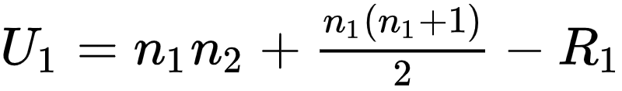
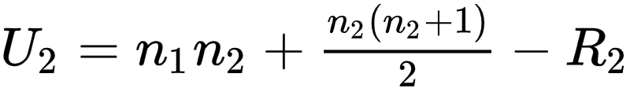
Mann-whitney U test
It is seen that for large n₁ and n₂ previous (direct) method is not feasible. Thus we can use the indirect method
The test statistic is defined as U = min{U₁, U₂}
Where
R₁ is the sum of ranks of 1st sample and R₂ is the sum of ranks of 2nd sample
U₁ + U₂ = n₁.n₂

Slide 78
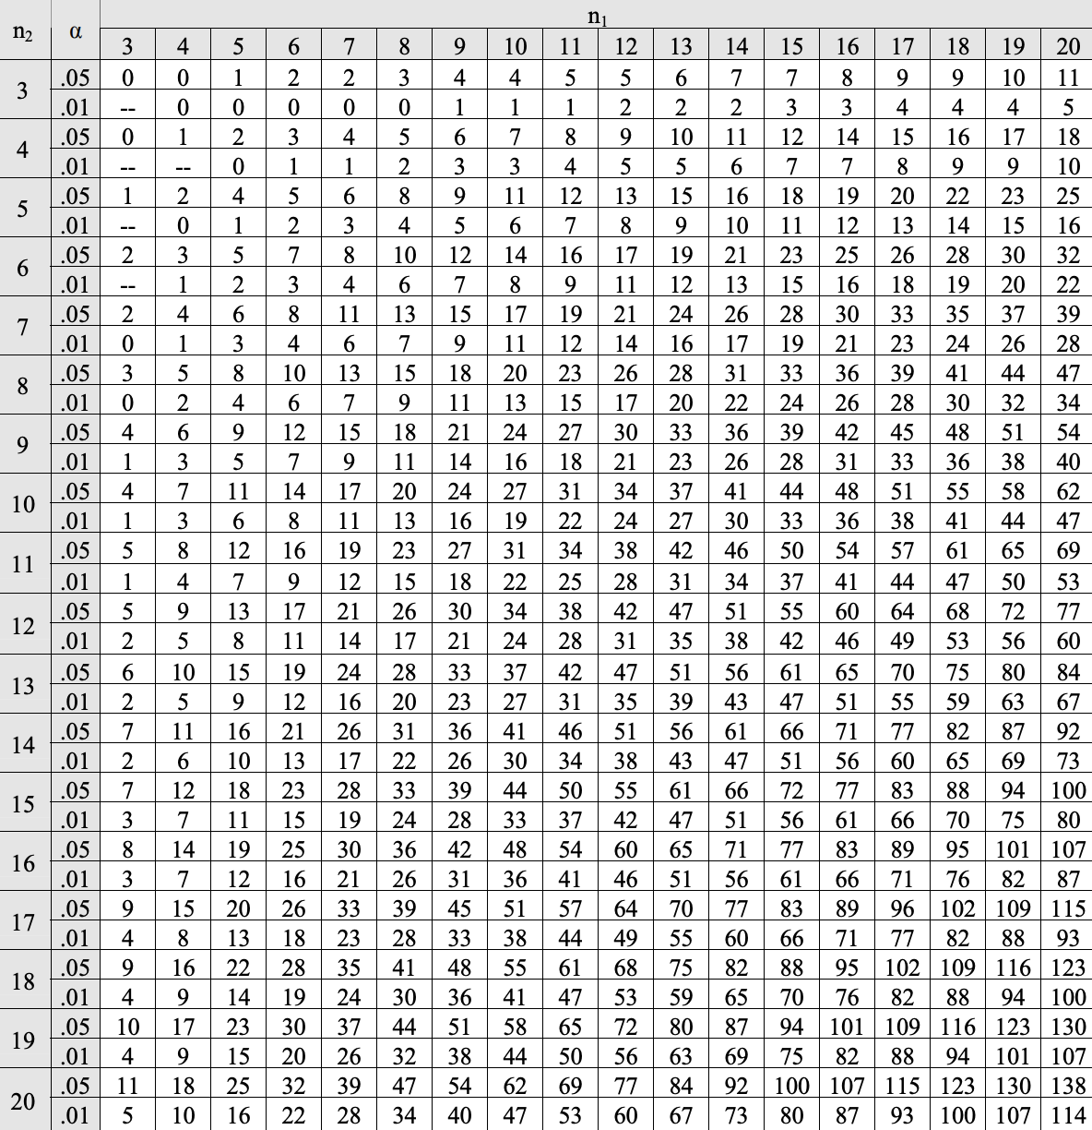
Mann-whitney U test - one tailed table

Slide 79
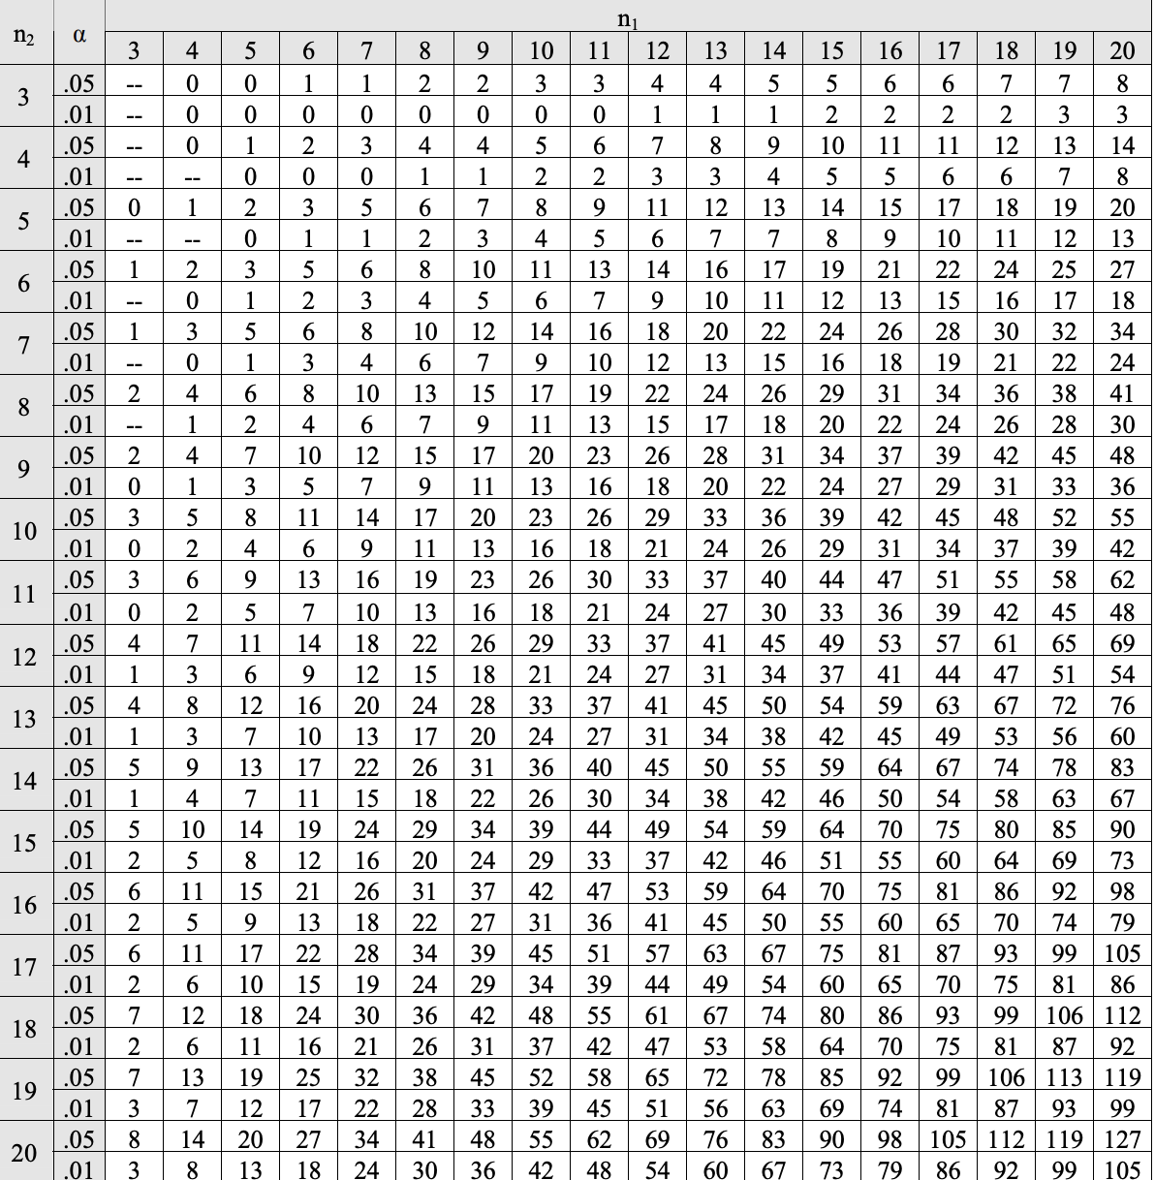
Mann-whitney U test - two tailed table

Slide 80
Non-parametric - unpaired data
Solution:
We have
Pooled sample | 32 | 31 | 33 | 46 | 49 | 20 | 58 | 55 | 52
Ordered Sample | 20 | 31 | 32 | 33 | 46 | 49 | 52 | 55 | 58
Rank | 1 | 2 | 3 | 4 | 5 | 6 | 7 | 8 | 9
 | Data from A
 | Data from B
R₁= 2+3+4+5 = 14 and R₂= 1+6+7+8+9 = 31

Slide 81
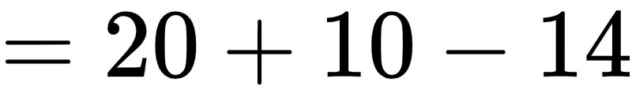
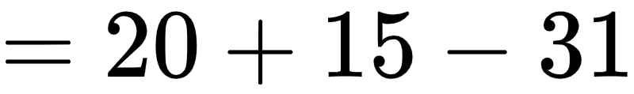
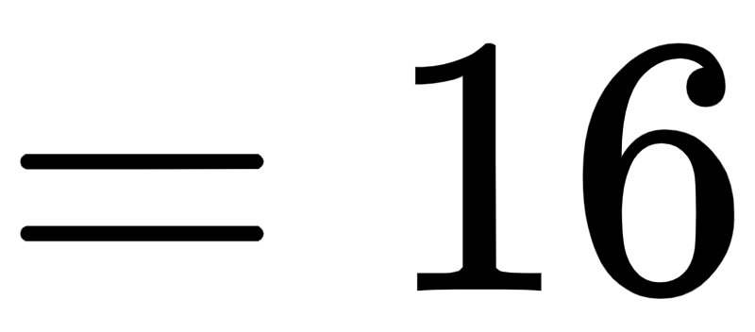
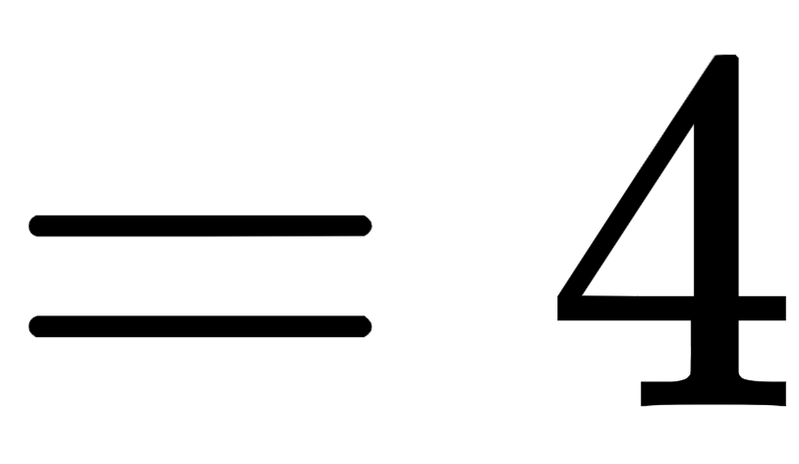
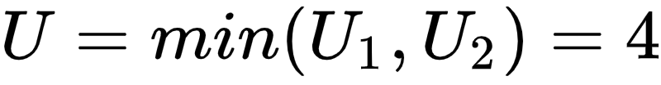
Non-parametric - unpaired data
Here, n₁ = 4 and n₂ = 5

Slide 82
Non-parametric - unpaired data
n₁
Solution:
The test statistic
The table value is 2.
Thus we fail to reject H₀. We can not conclude that the patients of hospital B tend to spend more time in the operating room than patients of hospital A

Slide 83
The python code to conduct Mann Whitney U test for unpaired data is
scipy.stats.stats.mannwhitneyu(Sample_1, Sample_2, alternative)

Slide 84
Post-Hoc Tests

Slide 85
Post-hoc test
A post hoc is conducted after the null hypothesis of ANOVA is rejected to determine the different treatments(s)
There are various post hoc tests available such as:
Tukey’s HSD test
Scheffe test
Duncan's Multiple Range test
Fisher's’ LSD test
Bonferroni test
We will study the Tukey’s HSD test in detail

Slide 86
Post-hoc test
Consider our example where Ryan wants to find out the which machines had different result
Each pair of machines is tested for the statistical difference
Machine B
Machine C
Machine A
Machine C
Machine B
Machine C
Machine D
Machine D
Machine D

Slide 87
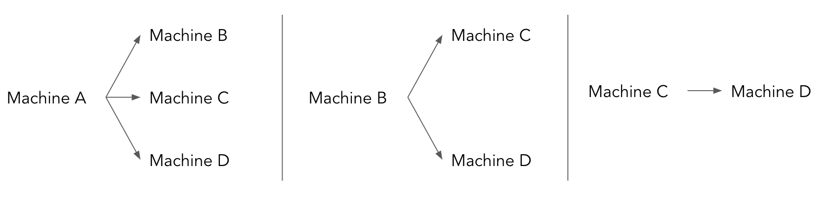
Post-hoc test
Thus the test hypothesis are
H₀₁: μ_{machine_A} = μ_{machine_B} Against H₁₁: μ_{machine_A} ≠ μ_{machine_B}
H₀₂: μ_{machine_A} = μ_{machine_C} Against H₁₂: μ_{machine_A} ≠ μ_{machine_C}
H₀₃: μ_{machine_A}= μ_{machine_D} Against H₁₃: μ_{machine_A} ≠ μ_{machine_D}
H₀₄: μ_{machine_B} = μ_{machine_C} Against H₁₄: μ_{machine_A} ≠ μ_{machine_C}
H₀₅: μ_{machine_B} = μ_{machine_D} Against H₁₅: μ_{machine_A} ≠ μ_{machine_D}
H₀₆: μ_{machine_C}= μ_{machine_D} Against H₁₆: μ_{machine_A} ≠ μ_{machine_D}

Slide 88
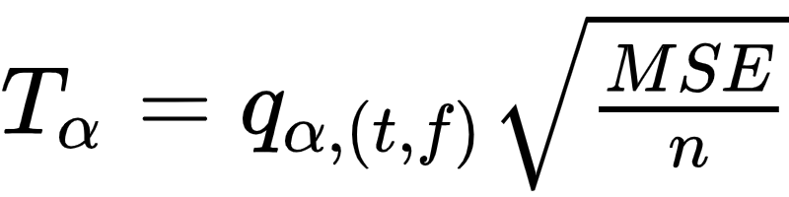
Post-hoc test
The test statistic is:
Obtained from the Tukey table
t: total treatments
f: error degrees of freedom
MSE: Mean error sum of squares (from ANOVA table)
n: number of observations in a group

Slide 89
Post-hoc test
Consider the absolute difference between two treatments |x̄_{i} - x̄_{j}|
The decision rule: Reject H₀, if the absolute difference ≥T_{α}
The python code: First create the DataFrame df_machine then use the following function

Slide 90
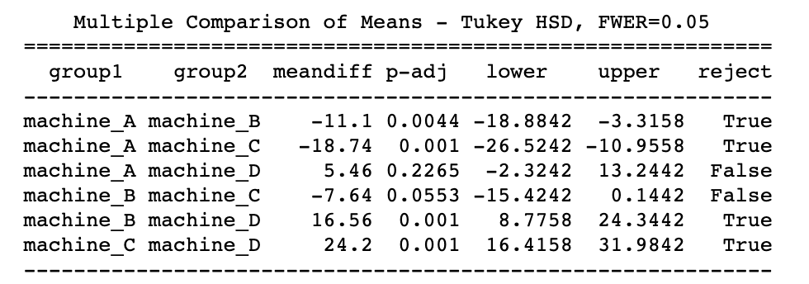
Post-hoc test
The output is as follows:
True: reject H₀
False: fail to reject H₀ (accept H₀)
It can been seen that there is statistical difference between pairs of machines (A,B), (A,C), (B,D), and (C,D).

Slide 91
For equal number of observations in each treatment, tukey HSD test can be used
However when the data is unequal it is not efficient
In such a scenario, one may use the Scheffe test

Slide 92
Kruskal Wallis H test

Slide 93
Kruskal Wallis H test
It is the non-parametric equivalent of ANOVA
Used when two or more independent samples when population is non-normal
The test hypothesis remains the same as that of ANOVA

Slide 94
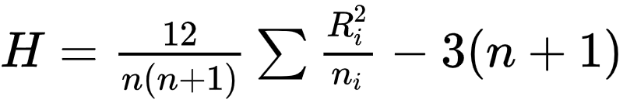
Kruskal Wallis H test - Procedure
Let n_{i} (i = 1, 2, … ,t) denote the number of observations a treatment
Combine all t samples so that there are n = n₁+ n₂+...+ n_{t} units in the sample
Arrange it in ascending order and rank them (rank 1 is given to the smallest observation, solve for ties)
The test statistic is given by
sum of ranks of observations in the i^{th} sample

Slide 95
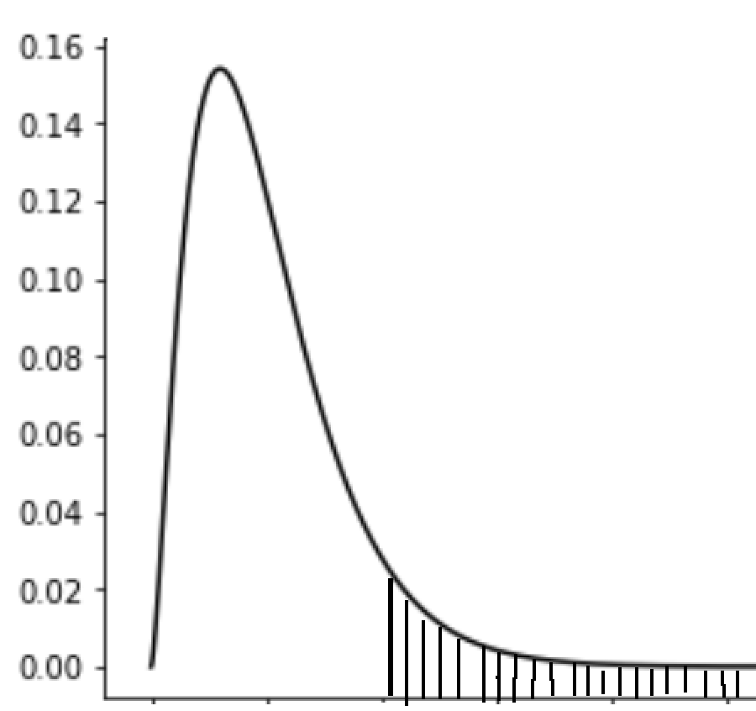

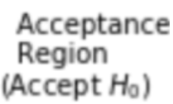
Kruskal Wallis H test
Note that each n_{i} > 5
Decision rule: Reject H₀ if H > χ²_{t-1,α}
χ²_{t-1,α}

Slide 96
Kruskal wallis H test
Question:
Ryan is a production manager at an industry manufacturing alloy seals. They have 3 machines - A, B and C. Ryan wants to study whether all the machines have equal efficiency. There no information about the tensile strength (in N/m²) of the population. Can it be said that the machines are produce the sample tensile strength?
Test at 5% level of significance.
A | B | C
72.5 | 33.2 | 24.5
84.8 | 23.4 | 34.6
76.6 | 35.7
34.7 | 33.7
 | 34.5

Slide 97
Kruskal wallis H test
Solution:
Ryan is a production manager at an industry manufacturing alloy seals. They have 4 machines - A, B, and C
Let µ₁ be the average tensile strength due to machine A µ₂ be the average tensile strength due to machine B µ₃ be the average tensile strength due to machine C
To test, H₀: µ₁ = µ₂ = µ₃ Against H₁: At least one µ_{i} is different (i=1,2,3)

Slide 98
Kruskal wallis H test
Sample treatment | Observation | Rank
B | 23.4 | 1
C | 24.5 | 2
B | 33.2 | 3
B | 33.7 | 4
B | 34.5 | 5
C | 34.6 | 6
A | 34.7 | 7
B | 35.7 | 8
A | 72.5 | 9
A | 76.6 | 10
A | 84.8 | 11
Solution:
First combine the sample and rank it.
Here n₁ = 4, n₂ = 5, n₃ = 2
Thus n = 4+5+2 =11
R₁ = 7+9+10+11 = 37 R₂ = 1+3+4+5+8 = 21 R₃ = 2+6 = 8

Slide 99
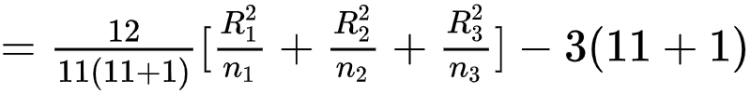

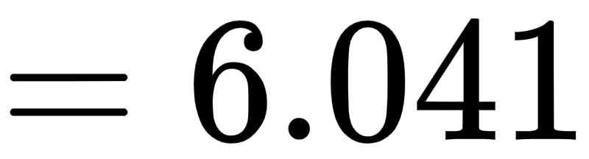
Kruskal wallis H test
Solution:
The test statistic is

Slide 100
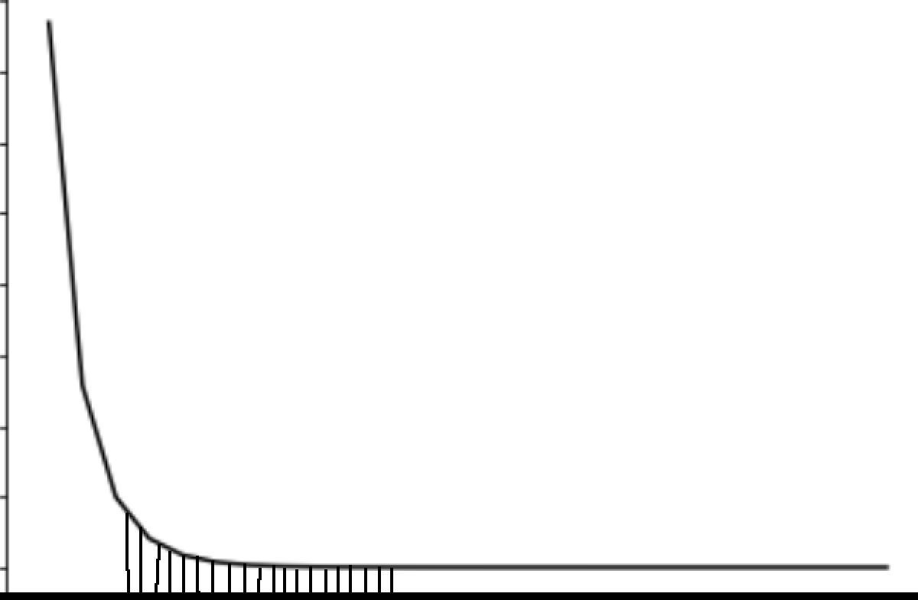
Kruskal wallis H test
Solution:
The test statistic H = 6.041
From the chi-square table we have χ²_{t-1,α} = χ²_{3-1,0.05} = 5.991
Since H > χ²_{t-1,α} ( 6.041 > 5.991), we fail to reject H₀
The associate p-value is 0.048 Since p-value < 0.05, we reject H₀.
Thus there is enough evidence to conclude that the tensile strength due to machines is different
5.991

Slide 101
The python code to conduct kruskal wallis H test is
scipy.stats.kruskal(sample_A, sample_B, sample_C)

Slide 102
Non-parametric post hoc test
The post hoc test performed after non-parametric Kruskal Wallis H test is conover test
It test is based on studentized range
The hypothesis remains the same as that of a parametric post-hoc test

Slide 103
Non-parametric post hoc test
Thus the test hypothesis for are our example are
H₀₁: μ_{machine_A} = μ_{machine_B} Against H₁₁: μ_{machine_A} ≠ μ_{machine_B}
H₀₂: μ_{machine_A} = μ_{machine_C} Against H₁₂: μ_{machine_A} ≠ μ_{machine_C}
H₀₃: μ_{machine_B} = μ_{machine_C} Against H₁₃: μ_{machine_A} ≠ μ_{machine_C}
Machine B
Machine A
Machine B
Machine C
Machine C

Slide 104
Non-parametric post hoc test
The post hoc test performed after non-parametric Kruskal Wallis H test is Conover test
The python code to conduct non-parametric post hoc test is
scikit_posthocs.posthoc_conover()

Slide 105
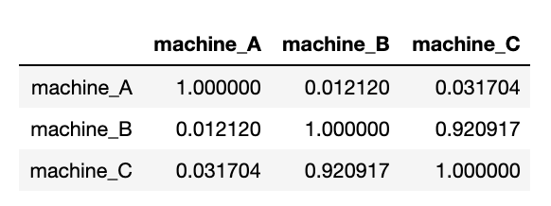
Non-parametric post hoc test
The output is as follows:
Reject H₀ if p-value is less than α
If α = 0.05, it can been seen that there is statistical difference between pairs of machines (A,B) and (A,C).

Slide 106
Summary
 | Parametric test | Non-parametric test
Equal groups | Tukey HSD | Conover test
Unequal groups | Scheffe test | Dunn’s multiple Comparison test

Slide 107
One - way ANOVA
Ryan only considered the effect of the machines on the tensile strength
What if he considers the effect of work shifts used?
The effect of the quality of material and the effect due to machine can be tested using two way ANOVA

Slide 108
Two way ANOVA

Slide 109
Two way ANOVA
The business is thriving, and Ryan finds it crucial that the production should progress without any breaks. He decides to have three shifts - Morning, Afternoon and Night shift.
Now there are two factors that may affect the tensile strength of the alloy wire.
The production machine
The workforce at each shift

Slide 110
Two way ANOVA
In two way ANOVA the effect due to two nominal variables can be tested over a numeric variable
Ryan can test for effect of machine on the tensile strength while he tests for effect due to shifts
Now the effect of machines can be considered as the treatments and the effect due to shifts are the blocks

Slide 111
Blocking
Previously, Ryan had only one shift that was working. So there was no possible variation that could occur
Now when he has 3 shifts the and possible variation due to these shifts may arise
The data becomes heterogeneous and can be made homogeneous
Blocking is used when the data is not homogeneous

Slide 112
Two way ANOVA
One of the null hypothesis to be tested is
Against
H₀₁: The averages of all treatments are same.
i.e. α₁ = α₂ = … = α_{n}
H₁₁: At the least one treatment has a different average
Failing to reject H₀₁, implies that all treatment have the same average

Slide 113
Two way ANOVA
Another null hypothesis to be tested is
Against
H₀₂: The averages of all blocks are same.
i.e. β₁ = β₂ = … = β_{n}
H₁₂: At the least one block has a different average
Failing to reject H₀₂, implies that all blocks have the same average

Slide 114
Two way ANOVA
Suppose Ryan collects data for tensile strength of wires produced by each machine at each shift
 | A | B | C | D
Morning Shift | 68.7 | 78.7 | 55.9 | 84.7
Afternoon Shift | 75.4 | 75.4 | 56.1 | 85.3
Night Shift | 80.9 | 80.9 | 57.3 | 87.9
There are 4 treatments (t = 4)
There are 3 blocks (b = 3)

Slide 115
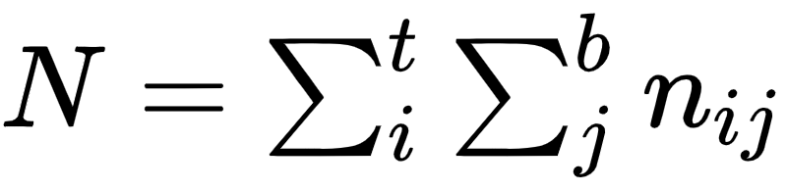
Two way ANOVA
Each treatment has 5 observations (n_{i} = 5) where i = 1, 2, …, t
Each block as 4 observations (b_{j} = 4) where j = 1, 2, …, b
Total number of observations is given by N
 | A | B | C | D
Morning Shift | 68.7 | 78.7 | 55.9 | 84.7
Afternoon Shift | 75.4 | 75.4 | 56.1 | 85.3
Night Shift | 80.9 | 80.9 | 57.3 | 87.9

Slide 116
Two way ANOVA
Let α_{i} (i=1, 2, …, t) denote the average strength due to each machine and β_{j} dnote the average strength due to the shift
For our example, t = 4 and b = 3
The test hypothesis can be written as
 | A | B | C | D
Morning Shift | 68.7 | 78.7 | 55.9 | 84.7
Afternoon Shift | 75.4 | 75.4 | 56.1 | 85.3
Night Shift | 80.9 | 80.9 | 57.3 | 87.9
H₀₁: α₁ = α₂ = α₃ = α₄
Against
H₁₁: At least α_{i} is different
H₀₂: β₁ = β₂ = β₃
Against
H₁₂: At least β_{j} is different

Slide 117
Two way ANOVA
In one way ANOVA, the entire population variance is split into two component
Variation due to treatments
Variation due to blocks
Error variation
Total variation = Treatment Variation + Block Variation + Error Variation

Slide 118
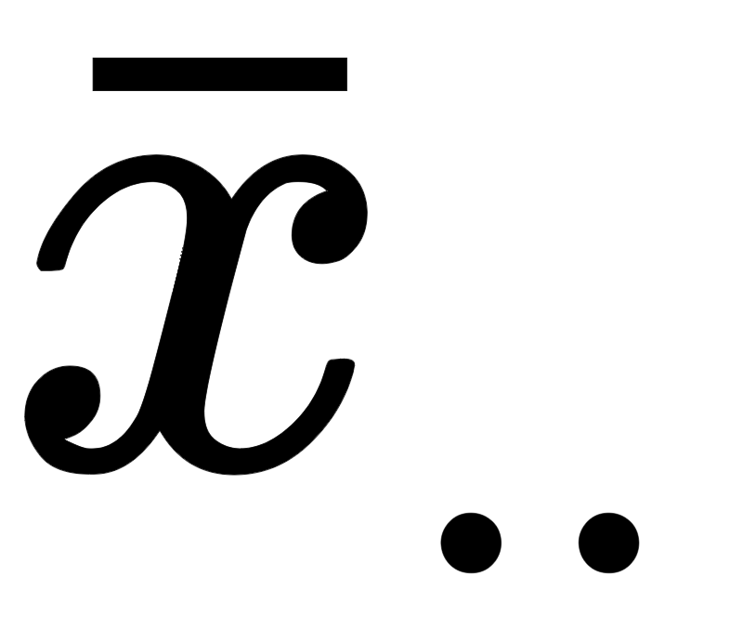
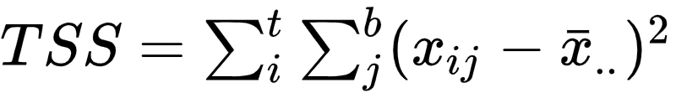
Total variation
It is the total sum of squares (TSS)
Let x_{ij} be the observations in the i^{th} treatment and j^{th} block
is the grand mean, i.e. the mean of all observations
The total variation is given by
Summation over the treatments
Summation over the blocks

Slide 119
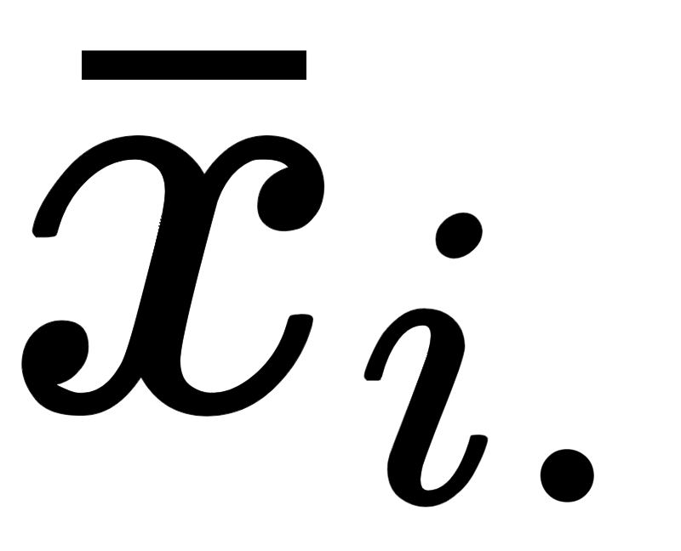
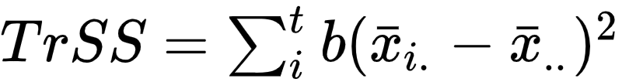
Treatment variation
It is the treatment sum of squares (TrSS)
Let x_{i.} be the observations in the i^{th} treatment with b observations in each treatment and is the mean over i^{th} treatment
is the grand mean, i.e. the mean of all observations
The treatment variation is given by
Summation over all treatments

Slide 120
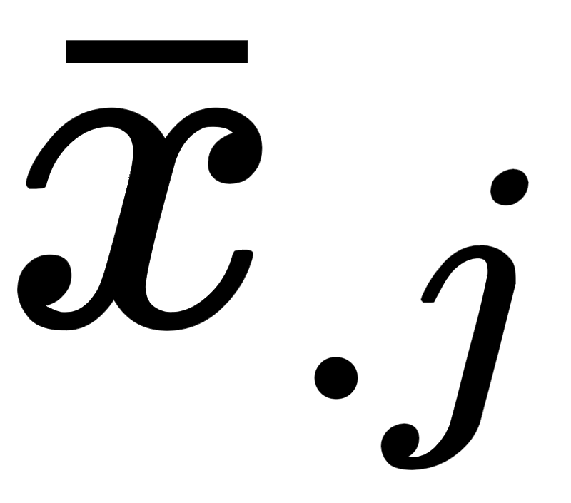
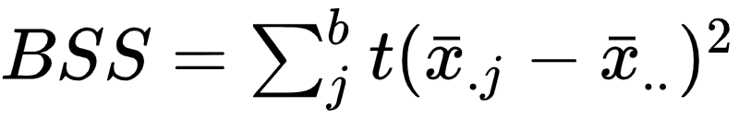
Block variation
It is the block sum of squares (BSS)
Let x_{.j} be the observations in the j^{th} block with t observations in each block and is the mean over j^{th} block
is the grand mean, i.e. the mean of all observations
The block variation is given by
Summation over all blocks

Slide 121

Error variation
It is the error sum of squares (ESS)
Let x_{i•} be the observations in the i^{th} treatment and is the mean over j^{th} block
is the grand mean, i.e. the mean of all observations
The error sum of squares is given by
Summation over all treatments
Summation over all blocks

Slide 122

Error sum of squares
During problem solving, the error sum of squares is obtained as:

Slide 123
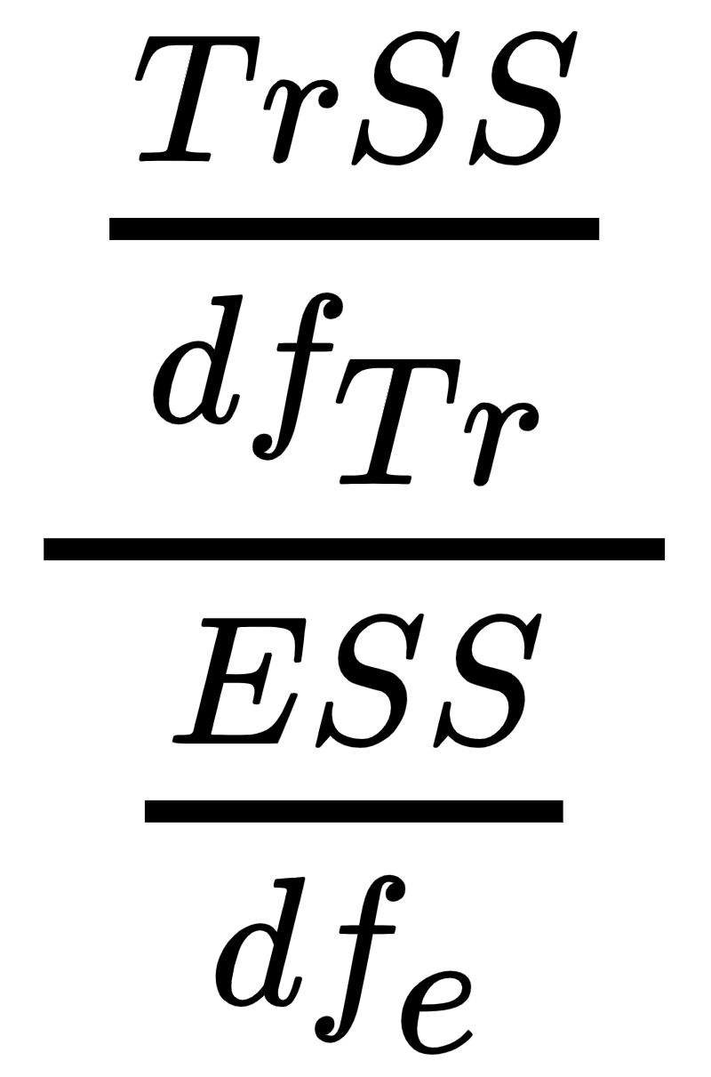
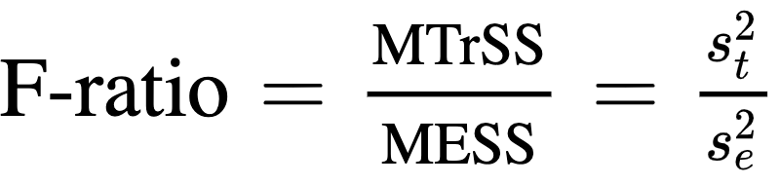
Two way ANOVA
The test statistic for treatments is given by
Under H₀, the test statistic follows F-distribution with (df_{Tr}, df_{e}) degrees of freedom
Decision Rule: If F_{cal} ≥ F_{(t-1, (t-1)(b-1)),α} then we reject H₀ at α% level of significance
Mean Treatment Sum of Squares (s²_{t})
Mean Error Sum of Squares (s²_{e})

Slide 124
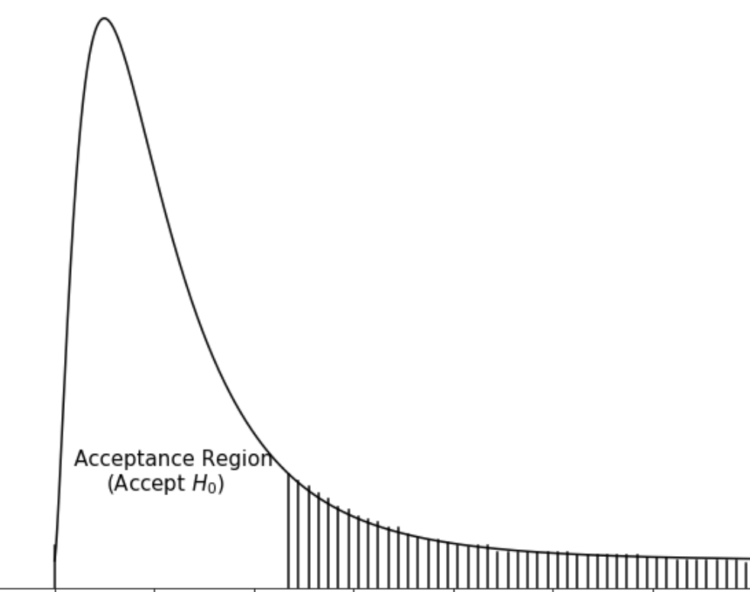
Two way ANOVA
Decision Rule: If F_{cal} ≥ F_{(t-1, (t-1)(b-1)),α} then we reject H₀ at α% level of significance
F_{(t-1, (t-1)(b-1)),α}

Slide 125
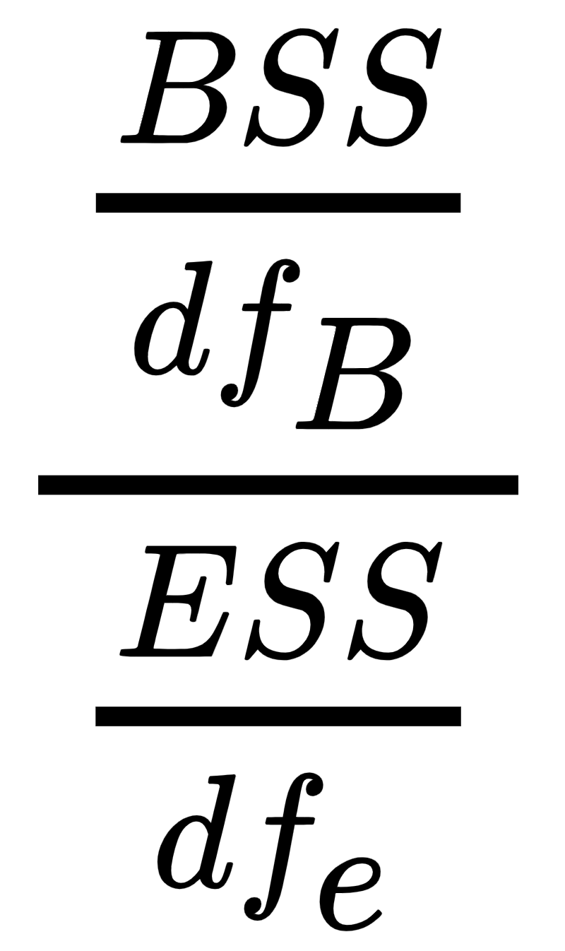

Two way ANOVA
The test statistic for blocks is given by
Under H₀, the test statistic follows F-distribution with (df_{B}, df_{e}) degrees of freedom
Decision Rule: If F_{cal} ≥ F_{(b-1, (t-1)(b-1)),α} then we reject H₀ at α% level of significance
Mean Block Sum of Squares (s²_{b})
Mean Error Sum of Squares (s²_{e})

Slide 126
Two way ANOVA
Decision Rule: If F_{cal} ≥ F_{(b-1, (t-1)(b-1)),α} then we reject H₀ at α% level of significance
F_{(b-1, (t-1)(b-1)),α}

Slide 127

Two way ANOVA
The two ANOVA table is given as follows:
Source of variation | Degrees of freedom | Sum of Squares | Mean Sum of Squares | F-ratio
Treatment | t-1 | TrSS | s²_{t}
Block | b-1 | BSS | s²_{b}
Error | (t-1)(b-1) | ESS | s²_{e}
Total | bt-1 | TSS

Slide 128
Two way ANOVA - procedure
State the hypothesis to be tested
Compute the sum of squares
The total sum of squares, TSS = ∑^{t}_{j=1}∑^{b}_{i=1} (x_{ij} - x̄..)²
The treatment sum of squares TrSS = ∑^{t}_{j=1} b ( x̄_{i.} -x̄..)²
The block sum of squares BSS = ∑^{b}_{i=1} t (x̄_{.j} - x̄..)²
The Error sum of squares, ESS = TSS - TrSS - BSS

Slide 129
Two way ANOVA - procedure
Compute mean sum of squares
s²_{t} = Mean treatment sum of squares (MTrSS) = TrSS/(t-1)
s²_{b} = Mean block sum of squares (MBSS) = BSS/(b-1)
s²_{e} = Mean error sum of squares (MESS) = ESS/[(t-1)(b-1)]

Slide 130


Two way ANOVA - procedure
Compute the F-ratios for
Treatment:
Block:
Prepare the ANOVA table
Write the decision and conclusion accordingly

Slide 131
Two way ANOVA
Question:
The business is thriving, and Ryan finds it crucial that the production should progress without any breaks. He decides to have three shifts - Morning, Afternoon and Night shift.
Ryan collects data of tensile strength (in N/m²) from all the 4 machines and the 3 shifts as given.
Test at 5% level of significance.
 | A | B | C | D
Morning Shift | 68.7 | 78.7 | 55.9 | 84.7
Afternoon Shift | 75.4 | 75.4 | 56.1 | 85.3
Night Shift | 80.9 | 80.9 | 57.3 | 87.9

Slide 132
Two way ANOVA
Solution:
There are 4 machines - A, B, C and D
Let α₁ be the average tensile strength due to machine A α₂ be the average tensile strength due to machine B α₃ be the average tensile strength due to machine C α₄ be the average tensile strength due to machine D
To test, H₀: α₁ = α₂ = α₃ = α₄ Against H₁: At least one α_{i} is different (i=1, 2, 3, 4)

Slide 133
Two way ANOVA
Solution:
There are 3 shifts - Morning, Afternoon and Night
Let β₁ be the average tensile strength due to Morning shift β₂ be the average tensile strength due to Afternoon shift β₃ be the average tensile strength due to Night shift
To test, H₀: β₁ = β₂ = β₃ Against H₁: At least one β_{i} is different (i=1, 2, 3)

Slide 134



Two way ANOVA
Solution:
The grand mean:
The total sum of squares
 | A | B | C | D
Morning Shift | 68.7 | 78.7 | 55.9 | 84.7
Afternoon Shift | 75.4 | 75.4 | 56.1 | 85.3
Night Shift | 80.9 | 80.9 | 57.3 | 87.9

Slide 135

Two way ANOVA
Solution:
The treatment sum of squares
 | A | B | C | D
Morning Shift | 68.7 | 78.7 | 55.9 | 84.7
Afternoon Shift | 75.4 | 75.4 | 56.1 | 85.3
Night Shift | 80.9 | 80.9 | 57.3 | 87.9
 | 75 | 78.33 | 56.43 | 85.97

Slide 136

Two way ANOVA
Solution:
The block sum of squares
 | A | B | C | D
Morning Shift | 68.7 | 78.7 | 55.9 | 84.7 | 72
Afternoon Shift | 75.4 | 75.4 | 56.1 | 85.3 | 73.05
Night Shift | 80.9 | 80.9 | 57.3 | 87.9 | 76.75

Slide 137

Two way ANOVA
Solution:
The treatment sum of squares is
Or it can be calculated as
 | A | B | C | D
Morning Shift | 68.7 | 78.7 | 55.9 | 84.7 | 72
Afternoon Shift | 75.4 | 75.4 | 56.1 | 85.3 | 73.05
Night Shift | 80.9 | 80.9 | 57.3 | 87.9 | 76.75
 | 75 | 78.33 | 56.43 | 85.97

Slide 138





Two way ANOVA
Solution:
Source of variation | Degrees of freedom | Sum of Squares | Mean Sum of Squares | F-ratio
Treatment | t-1 = 4-1 = 3 | TrSS = 1414.647
Block | b-1 = 3-1 = 2 | BSS = 49.8067
Error | (b-1)(t-1) = 6 | ESS = 47.1133
Total | bt-1 = 20 -1 =19 | TSS = 1511.567

Slide 139
Two way ANOVA
Solution:
For treatments, F-ratio = 60.0529
From the chi-square table we have F_{(t-1,(b-1)(t-1)),α} = F_{(3,6),0.05} = 4.76
Since F > F_{(3,6),α} ( 6.041 > 4.76), we reject H₀
There is enough evidence to conclude that the tensile strength due to machines is different
4.76

Slide 140
Two way ANOVA
Solution:
For Blocks, F-ratio = 3.17
From the chi-square table we have F_{(b-1,(b-1)(t-1)),α} = F_{(2,6),0.05} = 5.14
Since F < F_{(2,6),α} ( 3.17 < 5.14), we fail to reject H₀
There is enough evidence to conclude that the tensile strength due to shifts is same
F_{(b-1, (t-1)(b-1)),α}

